Slide 1
Sales Performance Dashboard
LAKSHAY SHARMA

Slide 2
Objective
To design an interactive dashboard for business analysis.
To analyze sales, profit, and order trend
To provide insights for better decision making

Slide 3
Dataset
Superstore Sales Dataset(Kaggle)
Contains information like:
1.Sales
2.Profit
3.Order Date
4.Region
5.Category

Slide 4
Key Performance Indicators(KPIs)
Total Sales:2.30M
Total Order:5009
Total Profit:286.40k

Slide 5
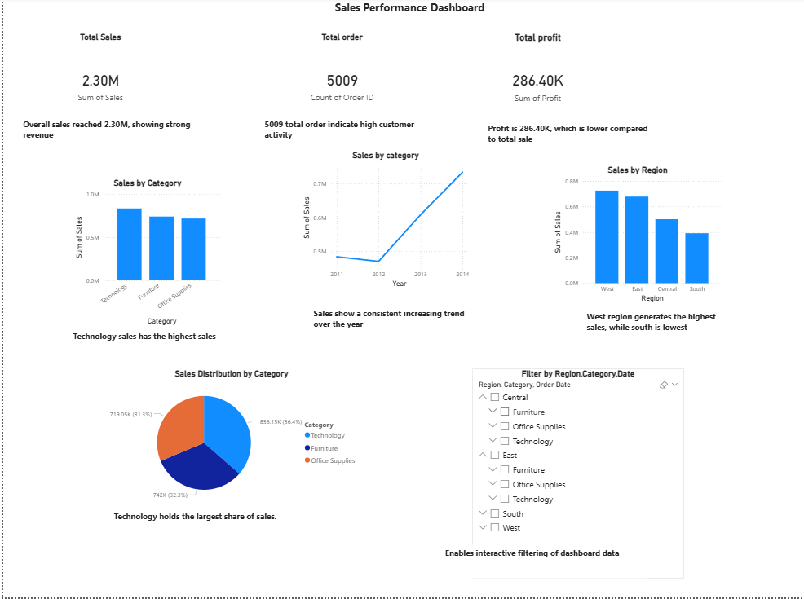
Dashboard
Interactive dashboard with filter and visualization

Slide 6
Insights
Sales show a consistent increasing trend over the years
Technology category has the highest sales
West region generates the highest sales
Profit is lower compared to total sales
Dashboard allows interactive filtering of data

Slide 7
Conclusion
Dashboard helps in understanding business performance
Provides clear insights for decision making
Interactive filters improve data exploration

Slide 8
Thank You

